Slide 1
Rockchip Company Presentation
July 2013

Slide 2
Contents
Rockchip Introduction
Product Roadmap Overview
Partner Overview

Slide 3
Rockchip Introduction

Slide 4
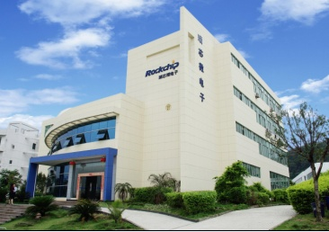
About Rockchip
Founded in Y2001
Headquarter in Fuzhou, China
3 branches in Shenzhen, Shanghai, and Beijing
More than 500 employees, 80% engineer
Focus on chip design & SOC total solutions on three product lines : Android Tablet, TV box, Smart TV, E-Book, Multi-Media Players, WIFI/ Bluetooth music box and in future --Wearable devices (Smart-watch/Smart-glasses)

Slide 5
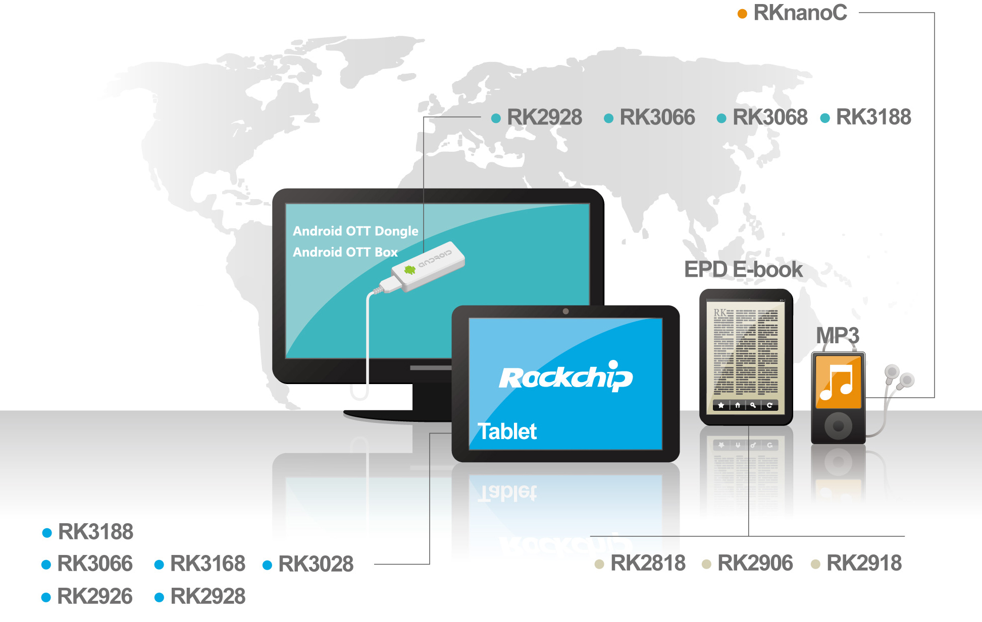
Product Structure

Slide 6
Product Roadmap

Slide 7
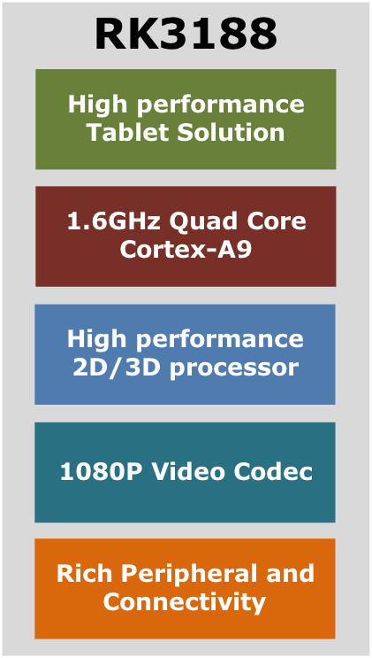
RK3188 Mobile Application Processor
Key Feature
Quad 1.6G ARM Cortex-A9 core
Full memory support, DDR3, LVDDR3, LPDDR2
Max 600M Mali-400 MP4 GPU, support OPENGL ES1.1/2.0, OPEN VG1.1,
High performance dedicated 2D processor
1080P multi format video decoding
1080P video encoding for H.264
Support dual-panel display
Support MLC NAND, eMMC
Rich peripheral and connectivity
Package
BGA453 19X19, 0.8mm pitch, Pin to Pin with RK3168
Availability
MP Ready
Specialist
Antutu 18000, Quadrant 5500, over 30% higher than Tegra3
World first Software based solution in H.265 and VP9 up to 1080P
Software based HDCP2.X
Support 2G/3G/4G
Support DVB-T/DVB-T2/ISDB-T

Slide 8
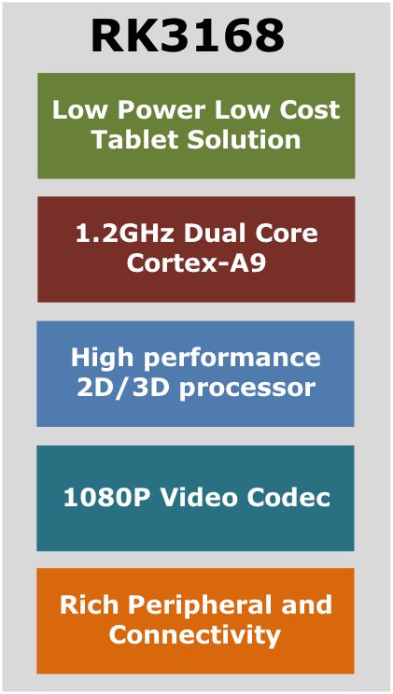
RK3168 Mobile Application Processor
Key Feature
28nm low power process
Dual 1.2G ARM Cortex-A9 core
Full memory support, DDR3, LVDDR3, LPDDR2
PowerVr SGX540 GPU, support OPENGL ES1.1/2.0, OPEN VG1.1, up to 600M
High performance dedicated 2D processor
1080P multi format video decoding
1080P video encoding for H.264
Support dual-panel display
Support MLC NAND, eMMC
Rich peripheral and connectivity
Package
RK3168: BGA453 19X19, 0.8mm pitch,
  Pin to Pin with RK3188
Availability
MP ready
Specialist
The lowest power consumption ( 550mw@720P video Playing)
Support 2G/3G
Lower cost and good performance

Slide 9

RK306X Mobile Application Processor
Key Feature
40nm low power process
Dual 1.6G ARM Cortex-A9 core
Mali-400MP4 Quad-core GPU
Full memory support, DDR3, DDR3L, LPDDR2
High performance dedicated 2D processor
1080P multi format video decoding, include WebM
1080P video encoding for WebM & H.264
Stereoscopic 3D H.264 MVC video Codec
Embed HDMI 1.4a, support 3D display
Embed 60bits ECC, support MLC NAND, eMMC
Dual panel display and dual camera supported
Rich peripheral and connectivity
Package
RK3066 BGA453 19X19, 0.8mm pitch
RK3068 BGA548 14X14, 0.5mm pitch
Availability
MP Now
Specialist
One of the best performance of dual core A9 AP
Support Software based H.265 / VP9@576P
About 20M shipment in 2013 including many Tier 1 customers
The most stable software after long term debug
Support 4G (FDD-LTE/TDD-LTE)
Support DVB-T/DVB-T2/ISDB-T
RK306X
Middle Level Tablet Soltution
1.6G Dual Core Cortex-A9
Mali-400MP4 GPU
&2D Processor
Stereoscopic 3D
HD Video Codec
Rich Peripheral &Connectivity

Slide 10
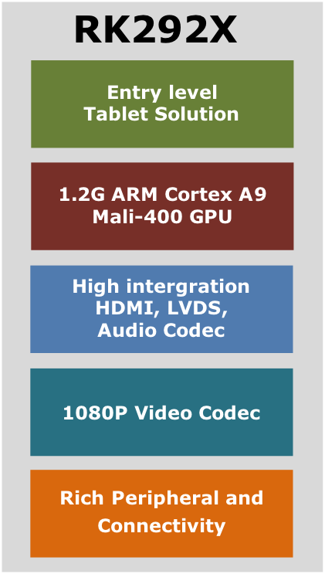
RK292X Application Processor
Key Feature
Single ARM Cortex-A9 core, up to 1.0GHz
16Bit Memory, support DDR3, LVDDR3
ARM Mali-400 GPU, support OPENGL ES1.1/2.0
High performance dedicated 2D processor
1080P multi format video decoding
1080P video encoding for H.264
Support MLC NAND, eMMC
Embed HDMI transmitter
Embed audio CODEC
Embed LVDS transmitter
Rich peripheral and connectivity
Embedded GPS baseband
Package
RK2926: LQFP176, 20X20mm, 1.0GHz
RK2928-G: BGA313, 0.8mm Pitch, 16X16, 1.0GHz
Availability
MP Ready
Specialist
Entry Level low cost tablet solution
low cost TV-BOX solution (called “wireless HDMI”),PCBA about USD$10

Slide 11
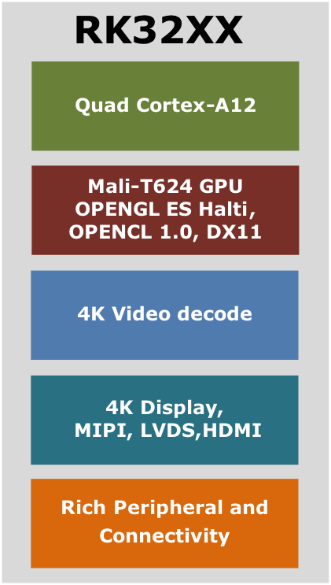
RK32 Application Processor
Key Feature
28nm HKMG Process
1.8GHz Quad ARM A12 core
ARM Mali-T624 GPU, support OPENGL ES1.1/2.0/Halti, OPEN VG1.1, OPENCL, Directx11
High performance dedicated 2D processor
Dual channels DDR controller, support, DDR3, DDR3L, LPDDR2, LPDDR3
Display resolution up to 3840X2160, MIPI, LVDS, HDMI transmitter
Embed 1300M ISP and MIPI-CSI interface
4K video multi format video decoding
1080P video encoding for H.264 and VP8, MVC
Support MLC NAND, eMMC
Image enhancement HW
Low power display improvement HW
Rich peripheral and connectivity
Availability
ES Q2 2014
Specialist
One of the world first Quad core A12
Ultra high performance
High integration SOC

Slide 12
Rockchip AP Summery
Series | RK2926 /RK2928 | RK3066 /RK3068 | RK3168 | RK3188
Process | 55nm | 40nm | 28nm HKGM | 28nm HKGM
CPU | A9 | Dual A9 | Dual A9 | Quad A9
MAX CPU Frequency | 1.0G | 1.6GHz | 1.2GHz | 1.6GHz
L1 | 32KB | 32KB | 32KB | 32KB
L2 | 128KB | 512KB | 256KB | 512KB
GPU | Mali400 | Mali-400MP4 | PowerVR 540 | Mali-400 MP4
MAX GPU Frequency | 330M | 400M | 600M | 600M
Memory | DDR3/L | LPDDR2 DDR3/L | LPDDR2 DDR3/L | LPDDR2 DDR3/L
FLASH support | eMMC MLC NAND | eMMC MLC NAND | eMMC MLC NAND | eMMC MLC NAND
Video Decoder | Multi-Format, VP8, H.264 | Multi-Format, VP8, H.264 MVC | Multi-Format, VP8, H.264 | Multi-Format, VP8, H.264, MVC
Video Encoder | H.264 | H.264, VP8, MVC | H.264 | H.264, VP8, MVC

Slide 13


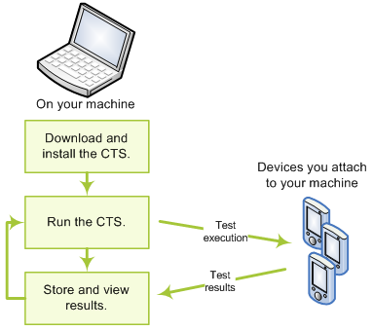
Rockchip’s VALUE to your Tablets
Plenty of experience with Google CTS/GMS
OTA (2010)
CTS Status
Rk2918 Gingerbread@2011-11, ICS@2012-2
Rk3066 ICS@2012-5
Wide vine DRM
Level3 & Level2 function DONE with Rk3066 & Rk2918
Several Brands got Google GMS authorization for RK2918 tablets.
Fuzhou Rockchip Electronics Co,. Ltd.

Slide 14
Key Partner Overview

Slide 15










International Brand

Slide 16






International Local King

Slide 17










Chinese Brand
Almost all china local consumer electronic brands are our customer.

Slide 18


Thank You!
Contact Us
Building No.18, A District,
Fuzhou Software Park,
89 Soft Avenue, Tongpan Road,
Gulou District, Fuzhou, Fujian, China
P.C: 350003
TEL: 86-591-83991906 FAX: 86-591-83951833

